Slide 1
Introduction

Slide 2
Why this subject?
To understand the functional components, characteristics, performance and interactions of a computer system.
Need to understand computer architecture in order to structure a program so that it runs more efficiently on a real machine.
To understand the tradeoff among various components such as CPU clock speed vs. memory size.

Slide 3
Text Books
W. Stallings, Computer organization and architecture, Prentice-Hall,2000
M. M. Mano, Computer System Architecture, Prentice-Hall
J. P. Hayes, Computer system architecture, McGraw Hill
J. L. Hennessy & D.A. Patterson, Computer architecture: A quantitative approach, Fourth Edition, Morgan Kaufman, 2004.

Slide 4
Evaluation procedure
Quiz → (10M)
Assignment → (10*2 = 20M)
CAT → 15*2 = 30M
Term End Exam → 40M

Slide 5
Introduction
What is computer?
A computer is a programmable machine that receives input, stores and manipulates data, and provides output in a useful format.

Slide 6
History of Computers

Slide 7

ABACUS -4th Century B.C.
The abacus, a simple counting aid, may have been invented in Babylonia (now Iraq) in the fourth century B.C.
This device allows users to make computations using a system of sliding beads arranged on a rack.

Slide 8
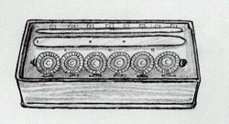
BLAISE PASCAL
(1623 - 1662)
In 1642, the French mathematician and philosopher Blaise Pascal invented a calculating device that would come to be called the "Adding Machine".

Slide 9
CHARLES BABBAGE
(1791 - 1871)
Born in 1791, Charles Babbage was an English mathematician and professor.
In 1822, he persuaded the British government to finance his design to build a machine that would calculate tables for logarithms.
With Charles Babbage's creation of the "Analytical Engine", (1833) computers took the form of a general purpose machine.

Slide 10
HOWARD AIKEN
(1900 - 1973)
Aiken thought he could create a modern and functioning model of Babbage's Analytical Engine.
He succeeded in securing a grant of 1 million dollars for his proposed Automatic Sequence Calculator; the Mark I for short. From IBM.
In 1944, the Mark I was "switched" on. Aiken's colossal machine spanned 51 feet in length and 8 feet in height. 500 meters of wiring were required to connect each component.
The Mark I did transform Babbage's dream into reality and did succeed in putting IBM's name on the forefront of the burgeoning computer industry. From 1944 on, modern computers would forever be associated with digital intelligence.

Slide 11
ENIAC 1946
Electronic Numerical Integrator And Computer
Under the leadership of J. Presper Eckert (1919 - 1995) and John W. Mauchly (1907 - 1980) the team produced a machine that computed at speeds 1,000 times faster than the Mark I was capable of only 2 years earlier.
Using 18,00-19,000 vacuum tubes, 70,000 resistors and 5 million soldered joints this massive instrument required the output of a small power station to operate it.
It could do nuclear physics calculations (in two hours) which it would have taken 100 engineers a year to do by hand.
The system's program could be changed by rewiring a panel.

Slide 12
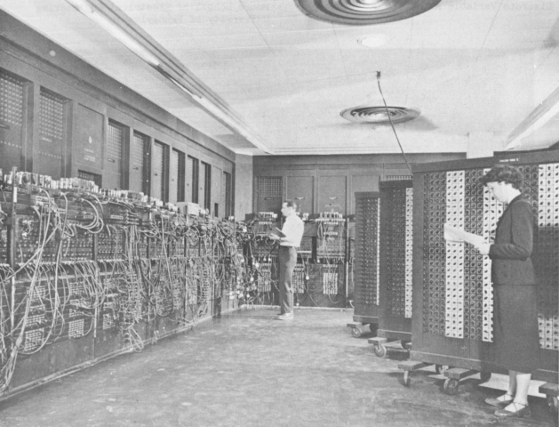
ENIAC
1946

Slide 13
TRANSISTOR 1948
In the laboratories of Bell Telephone, John Bardeen, Walter Brattain and William Shockley discovered the "transfer resistor"; later labelled the transistor.
Advantages:
increased reliability
1/13 size of vacuum tubes
consumed 1/20 of the electricity of vacuum tubes
were a fraction of the cost

Slide 14
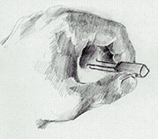
TRANSISTOR
1948
This tiny device had a huge impact on and extensive implications for modern computers. In 1956, the transistor won its creators the Noble Peace Prize for their invention.

Slide 15
ALTAIR 1975
The invention of the transistor made computers smaller, cheaper and more reliable. Therefore, the stage was set for the entrance of the computer into the domestic realm. In 1975, the age of personal computers commenced.
Under the leadership of Ed Roberts the Micro Instrumentation and Telemetry Company (MITS) wanted to design a computer 'kit' for the home hobbyist.
Based on the Intel 8080 processor, capable of controlling 64 kilobyes of memory, the MITS Altair - as the invention was later called - was debuted on the cover of the January edition of Popular Electronics magazine.
Presenting the Altair as an unassembled kit kept costs to a minimum. Therefore, the company was able to offer this model for only $395. Supply could not keep up with demand.

Slide 16
IBM (PC)
1981
On August 12, 1981 IBM announced its own personal computer.
Using the 16 bit Intel 8088 microprocessor, allowed for increased speed and huge amounts of memory.
Unlike the Altair that was sold as unassembled computer kits, IBM sold its "ready-made" machine through retailers and by qualified salespeople.

Slide 17
IBM (PC)
1981
To satisfy consumer appetites and to increase usability, IBM gave prototype IBM PCs to a number of major software companies.
For the first time, small companies and individuals who never would have imagined owning a "personal" computer were now opened to the computer world.

Slide 18
Computer
Generations

Slide 19

FIRST GENERATION
(1945-1956)
First generation computers were characterized by the fact that operating instructions were made-to-order for the specific task for which the computer was to be used.
Each computer had a different binary-coded program called a machine language that told it how to operate. This made the computer difficult to program and limited its versatility and speed.
Other distinctive features of first generation computers were the use of vacuum tubes (responsible for their breathtaking size) and magnetic drums for data storage.

Slide 20
First Generations
Vacuum Tubes
Magnetic Drum
4,000 bits
Hard Wire Programs in computers
IBM 650, Univac I
ENIAC

Slide 21
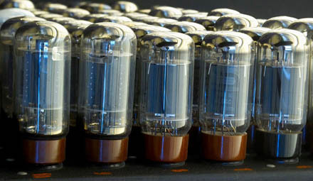
Vacuum Tubes

Slide 22
SECOND GENERATION
(1956-1963)
Throughout the early 1960's, there were a number of commercially successful second generation computers used in
business,
universities, and
government from companies such as Burroughs, Control Data, Honeywell, IBM, Sperry-Rand, and others.
These second generation computers were also of solid state design, and contained transistors in place of vacuum tubes.

Slide 23

THIRD GENERATION
(1965-1971)
Though transistors were clearly an improvement over the vacuum tube, they still generated a great deal of heat, which damaged the computer's sensitive internal parts.
The quartz rock eliminated this problem. Jack Kilby, an engineer with Texas Instruments, developed the integrated circuit (IC) in 1958.
The IC combined three electronic components onto a small silicon disc, which was made from quartz.
Scientists later managed to fit even more components on a single chip, called a semiconductor.
As a result, computers became ever smaller as more components were squeezed onto the chip. Another third-generation development included the use of an operating system that allowed machines to run many different programs at once with a central program that monitored and coordinated the computer's memory.

Slide 24
FOURTH GENERATION
(1971-Present)
In 1981, IBM introduced its personal computer (PC) for use in the home, office and schools.
The 1980's saw an expansion in computer use in all three arenas as clones of the IBM PC made the personal computer even more affordable.
The number of personal computers in use more than doubled from 2 million in 1981 to 5.5 million in 1982.

Slide 25
FOURTH GENERATION
(1971-Present)
Ten years later, 65 million PCs were being used. Computers continued their trend toward a smaller size, working their way down from desktop to laptop computers (which could fit inside a briefcase) to palmtop (able to fit inside a breast pocket).
In direct competition with IBM's PC was Apple's Macintosh line, introduced in 1984. Notable for its user-friendly design, the Macintosh offered an operating system that allowed users to move screen icons instead of typing instructions

Slide 26
FIFTH GENERATION
(Future)
Many advances in the science of computer design and technology are coming together to enable the creation of fifth-generation computers.
Two such engineering advances are parallel processing, which replaces von Neumann's single central processing unit design with a system harnessing the power of many CPUs to work as one.
Another advance is superconductor technology, which allows the flow of electricity with little or no resistance, greatly improving the speed of information flow.

Slide 27
FIFTH GENERATION
(Future)
Computers today have some attributes of fifth generation computers.
For example, expert systems assist doctors in making diagnoses by applying the problem-solving steps a doctor might use in assessing a patient's needs.
It will take several more years of development before expert systems are in widespread use.

Slide 28
FIFTH GENERATION
CHARACTERISTICS
1) Super large scale integrated chips. 2) They will have artificial intelligence. 3) They will be able to recognize image and graphs. 4) To be able to solve highly complex problem including decision making, logical reasoning. 5) More than one CPU for faster processing. 6) To work with natural language.

